Slide 1
Research Computing Services
Unix Command Line
https://github.com/nuitrcs/intro-command-line-april-2019
Dusan Ramljak: dusan.ramljak@northwestern.edu
Christina Maimone: christina.maimone@northwestern.edu
Slides borrowed from Janna Nugent,
Alper Kinaci, and Christina Maimone

Slide 2
Introduction
Please introduce yourself
Name
Affiliation/Department
Why you are here

Slide 3
Unix Command Line
With Bonus vi!

Slide 4
Goal
We will be working exclusively in Command line
Extended material is available for you on
http://github.com/nuitrcs/intro-command-line-april-2019
Goal is to get accustomed to command line environment

Slide 5
Objectives
Questions for the first part:
What is a command shell and why would I use one?
Objectives:
Explain how the shell relates to the keyboard, the screen, the operating system, and users' programs
Explain when and why command-line interfaces should be used instead of graphical interfaces

Slide 6
Background
At a high level, computers do four things:
run programs
store data
communicate with each other, and
interact with us

Slide 7
Bash
The Shell - a program which runs other programs
(rather than doing calculations itself)
The most popular Unix shell is Bash
The Bourne Again SHell
Derived from a shell written by Stephen Bourne
Bash is the default shell on
Unix
Linux
Packages providing Unix-like tools for Windows

Slide 8

Designed for ease of use:

Slide 9
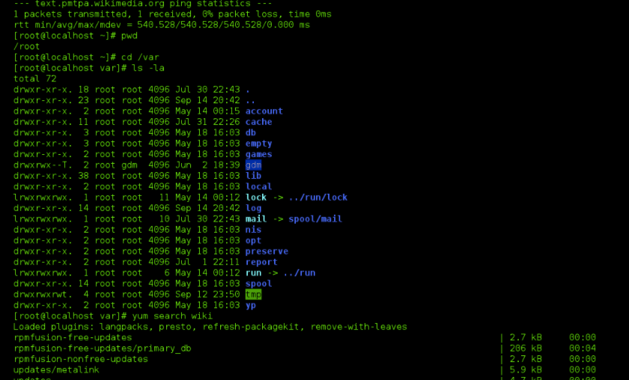

Designed for power
NOT
Designed for ease of use:

Slide 10
Where you will see it?
Older (way way older) computers
Linux
Unix
HPC
Remote servers

Slide 11
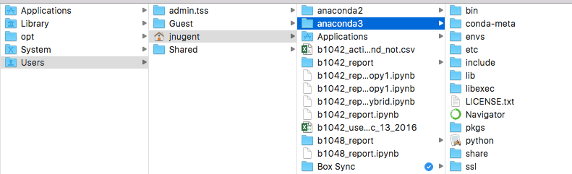
Finder on a Mac

Slide 12
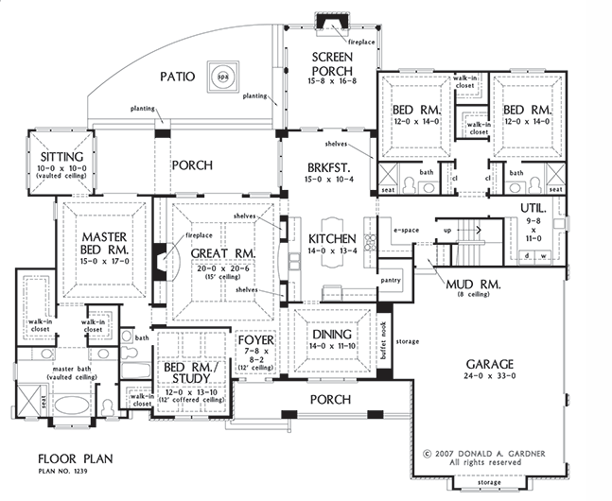
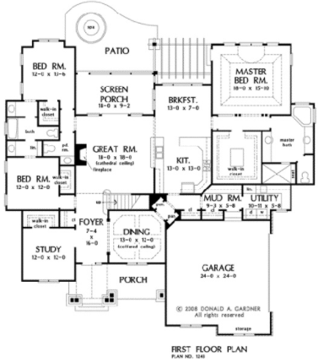
Finder on a Mac

Slide 13
looking around at files in Unix
$ pwd
/c/Users/dri9634/Desktop
$ ls
chunk_accesses/ data-shell.zip 'GitHub Desktop.lnk'* Python/
data-shell/ desktop.ini jupiterNotebooks/
$ cd data-shell
$ pwd
/c/Users/dri9634/Desktop/data-shell
$ ls
creatures/ data/ molecules/ north-pacific-gyre/ notes.txt pizza.cfg solar.pdf writing/

Slide 14
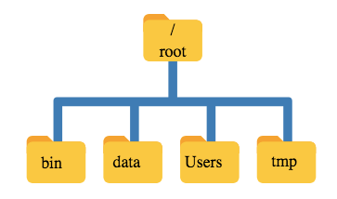

Slide 15

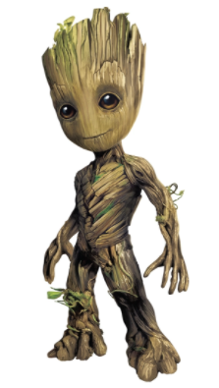
“Root”
a location: the base of the filesystem tree
/
a user: the superuser

Slide 16
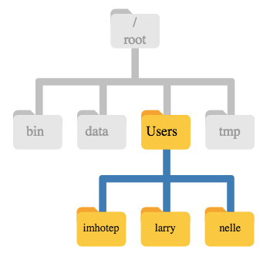

Slide 17
Finder on a Mac

Slide 18

Getting Started
Launch terminal
Let the fun begin!

Slide 19
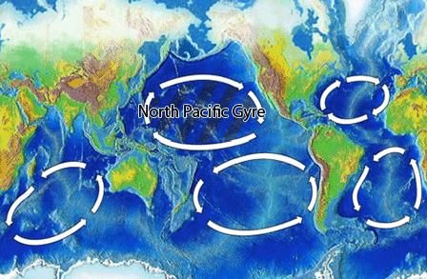
North Pacific Gyre
Great Pacific Garbage Patch

Slide 20
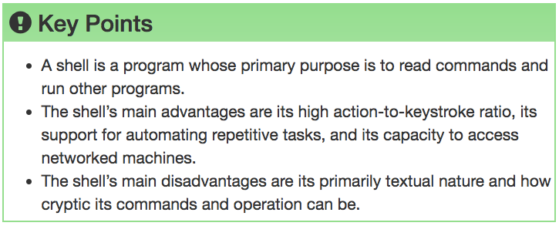

Slide 21

Navigating Files & Directories

Slide 22
Questions
How can I move around on my computer?
How can I see what files and directories I have?
How can I specify the location of a file or directory on my computer?

Slide 23
Objectives
Explain: file and directory similarities and differences
Translate: absolute path into a relative path and vice versa
Construct: absolute and relative paths that identify specific files and directories
Demonstrate: the use of tab completion and its advantages

Slide 25
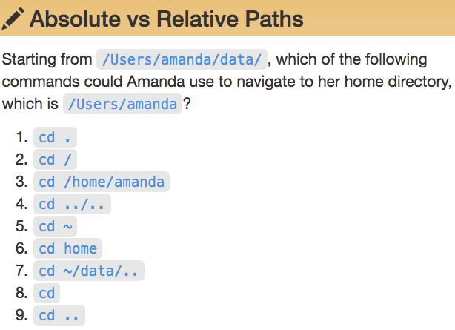
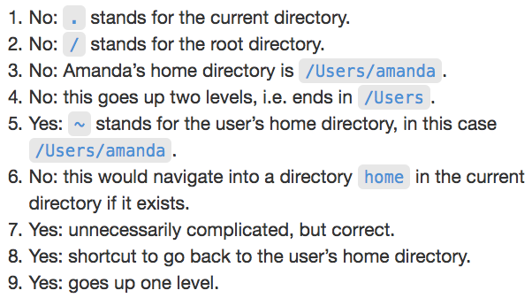


Slide 26
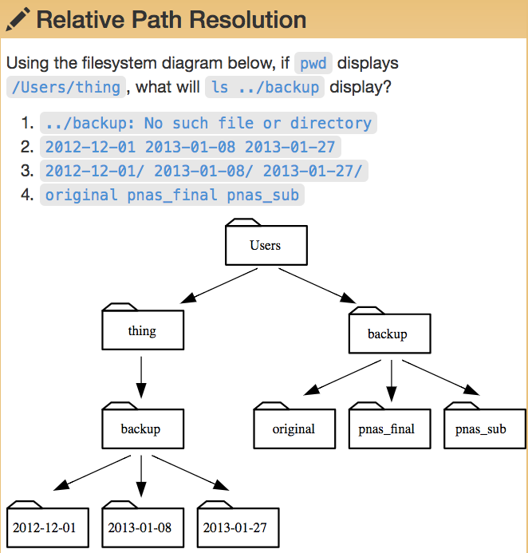

Slide 27
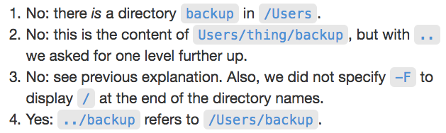
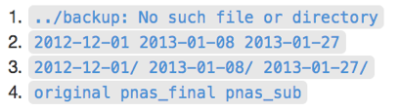

Slide 28
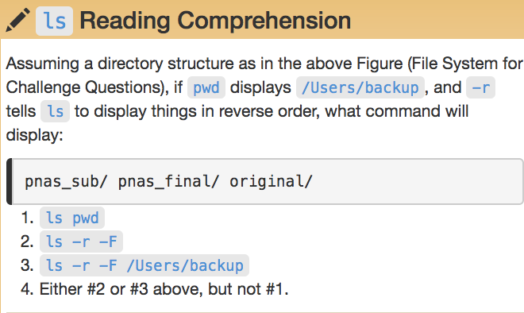
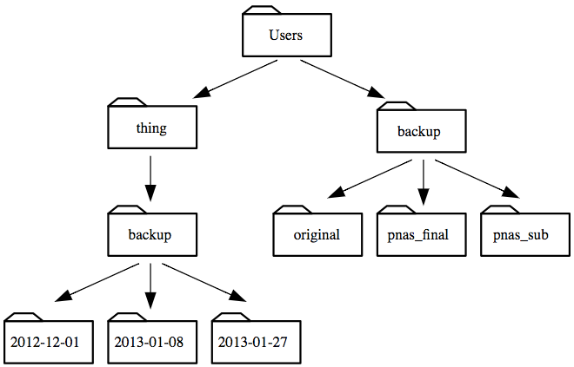

Slide 30
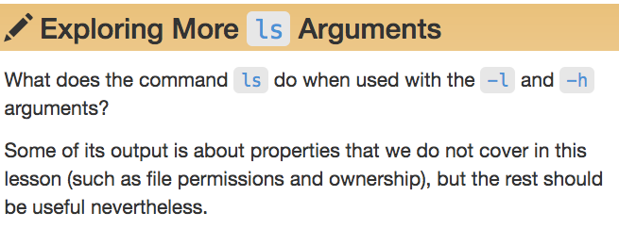
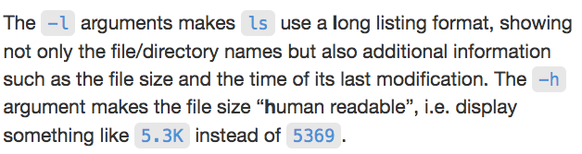

Slide 31
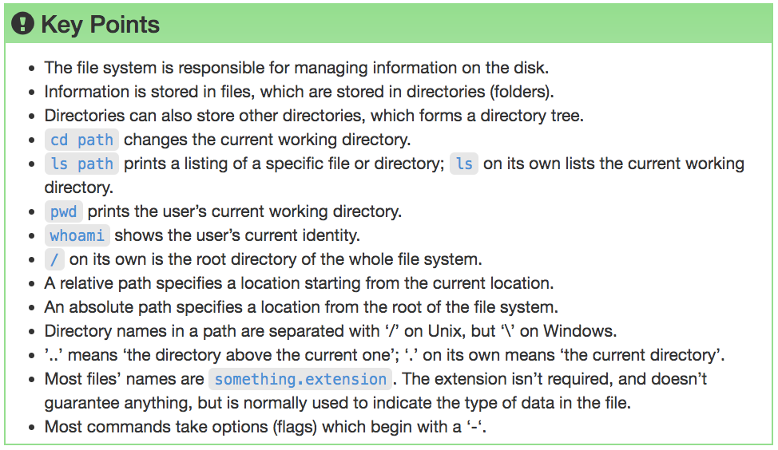

Slide 32
Working With Files & Directories

Slide 33
Questions
How can I create, copy, and delete files and directories?
How can I edit files?

Slide 34
Objectives
Create a directory hierarchy that matches a given diagram
Create files in that hierarchy using an editor or by copying and renaming existing files
Delete, copy and move specified files and/or directories

Slide 35
Good Names for Files & Directories
Don’t use whitespace (“my work”)
Don’t begin the name with a dash “-”
Don’t begin the name with a “.” unless you mean it
Use letters, numbers, “-”, “.”, “_”
If you need to use a filename with special characters,
surround the name in quotes (“- a bad name !”)

Slide 37
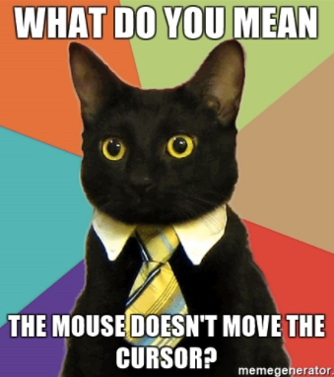
text editor: nano
type “nano <filename>” this will open the named file for editing or create it if it doesn’t exist
type your text: the mouse will not move the cursor - navigate with the arrow keys
save and quit: commands are on the bottom of the screen - the “^” stands for “control”

Slide 38
text editor: vi/vim
On command line: “vi test.txt”
You land in command mode
To enter insert mode: “i” where the cursor is; “o” inserts one line below that
Navigate with arrow keys
To exit insert mode: “esc”
To save: “:w”
To exit: “:q”
To exit without saving: “q!”

Slide 40
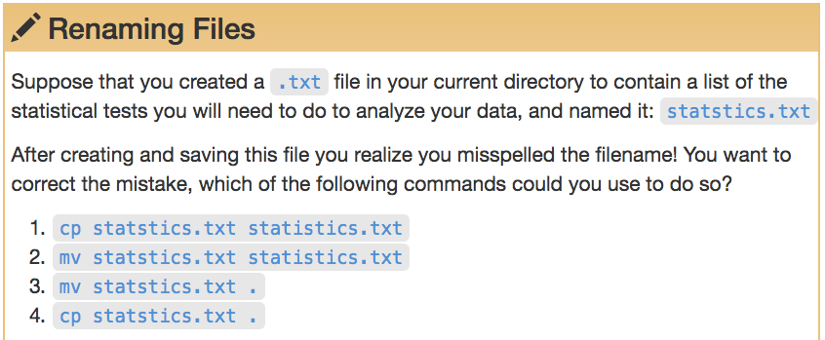
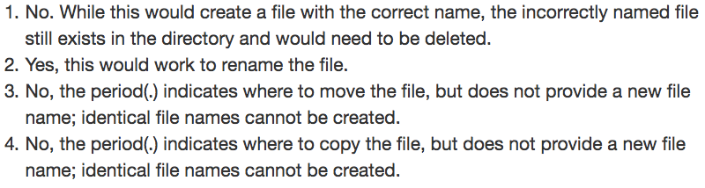

Slide 41
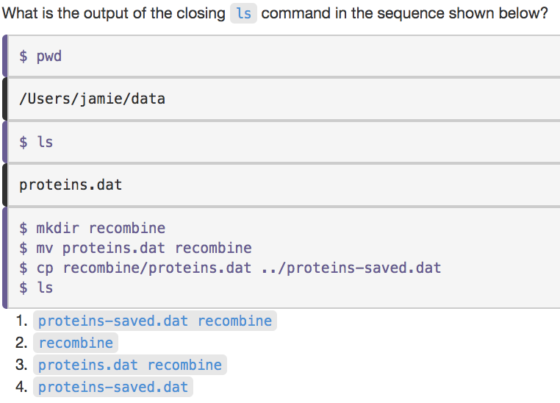

Slide 42
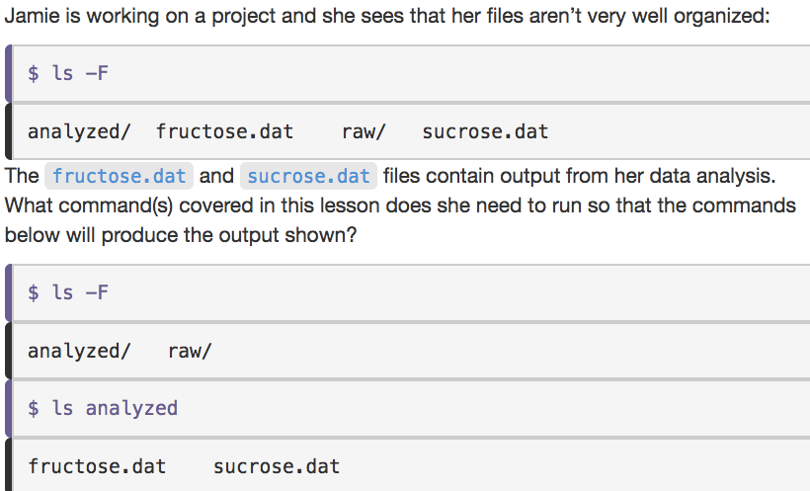

Slide 43
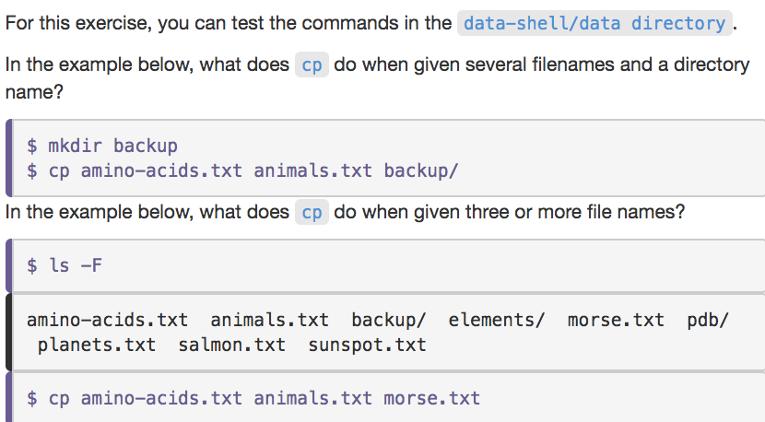
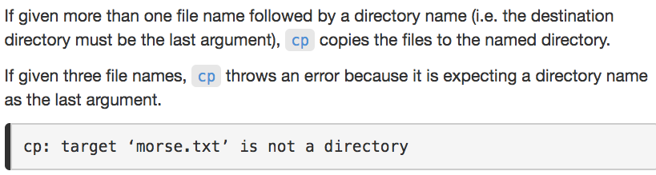

Slide 44
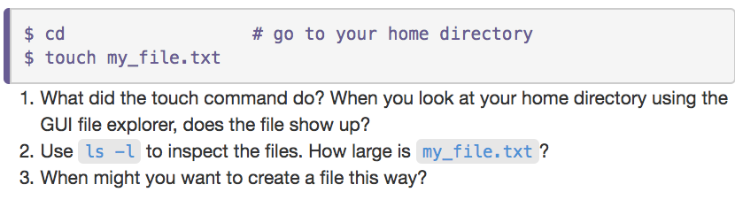

Slide 45
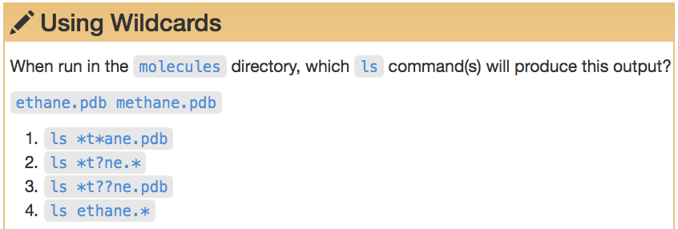
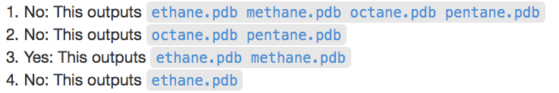

Slide 46
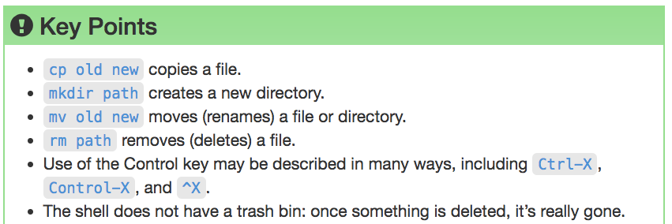

Slide 47
Pipes & Filters

Slide 48
Questions
How can I combine existing commands to do new things?

Slide 49
Objectives
Redirect a command's output to a file
Process a file instead of keyboard input using redirection
Construct command pipelines with two or more stages
Explain what usually happens if a program or pipeline isn't given any input to process
Explain Unix's 'small pieces, loosely joined' philosophy

Slide 51
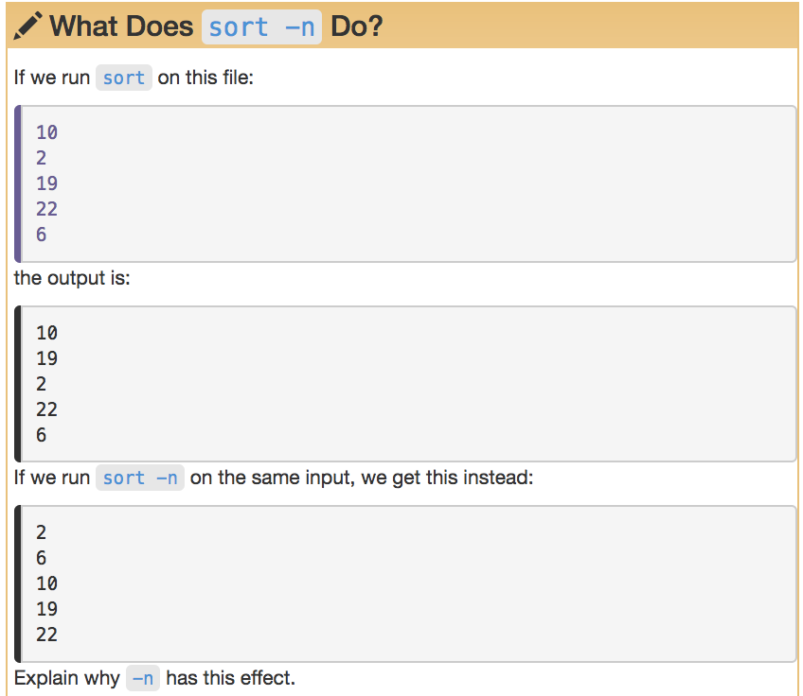

Slide 53
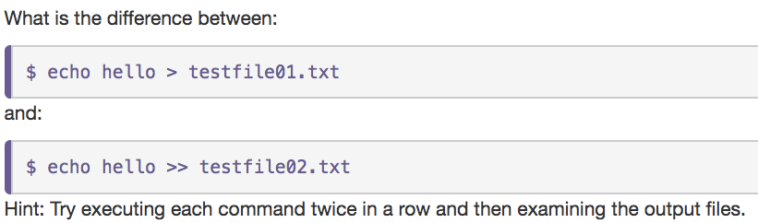

Slide 55
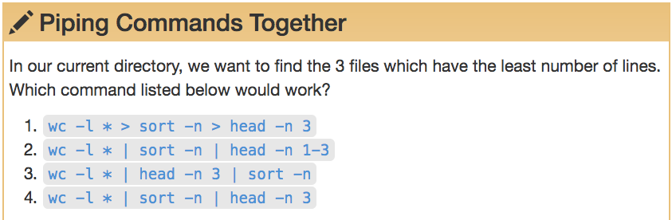
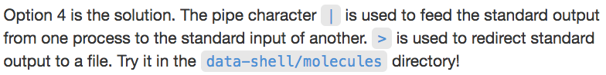

Slide 56
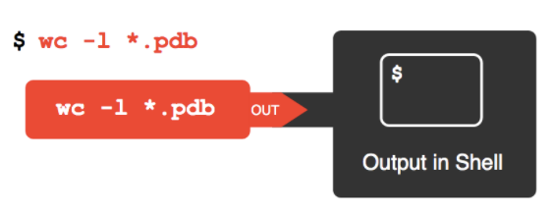

Slide 57
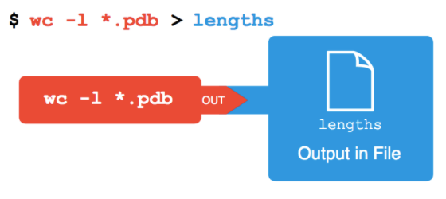

Slide 58
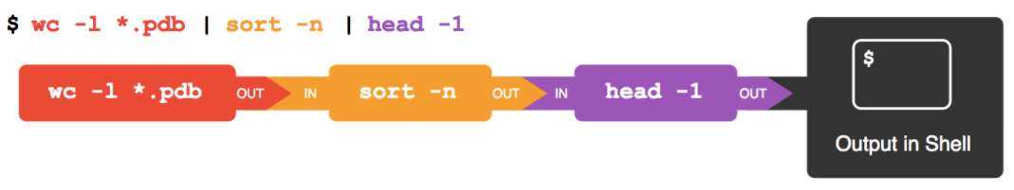

Slide 59
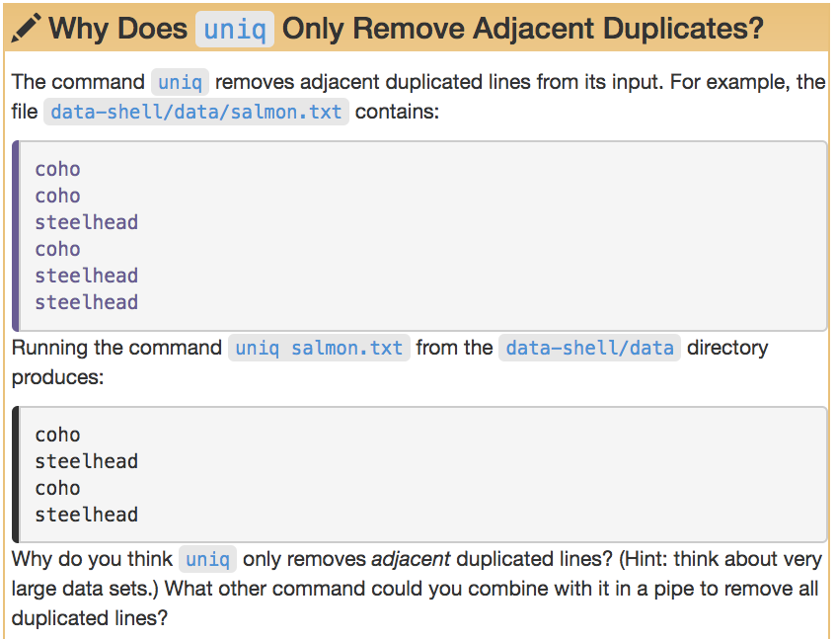

Slide 60
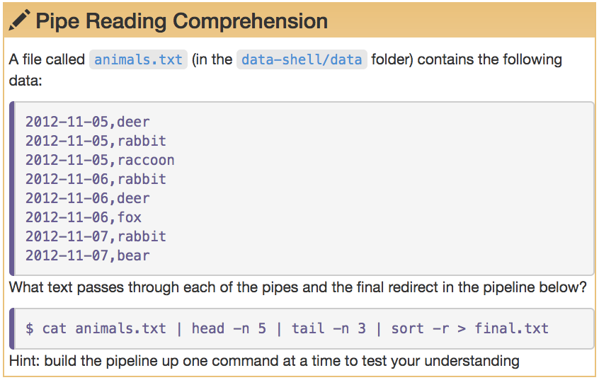

Slide 61
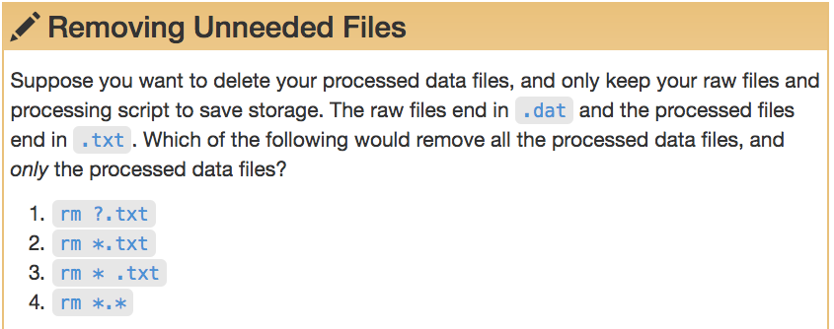

Slide 62
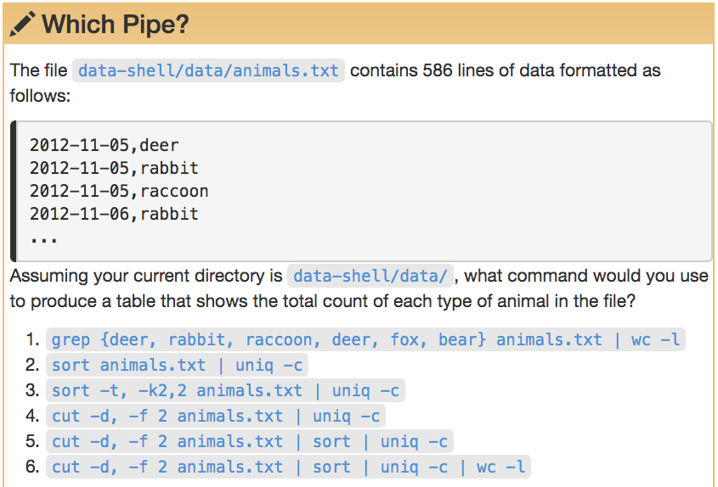

Slide 63
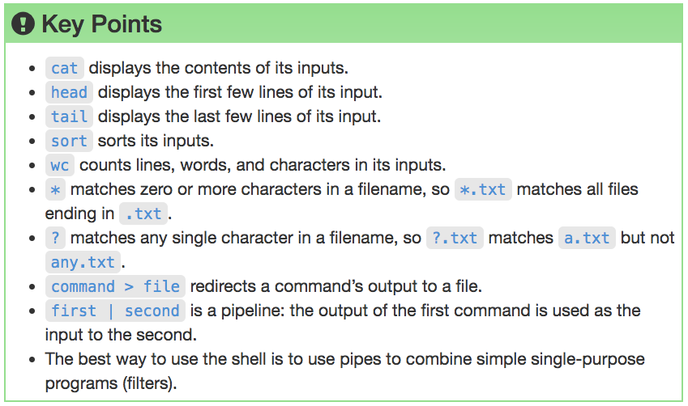

Slide 64
Research Computing Services
Unix Command Line
https://github.com/nuitrcs/intro-command-line-april-2019
Dusan Ramljak: dusan.ramljak@northwestern.edu
Christina Maimone: christina.maimone@northwestern.edu
Slides borrowed from Janna Nugent,
Alper Kinaci, Christina Maimone

